Slide 1
Chương 2: Lập trình ứng dụng windows Froms

Slide 2
MỤC TIÊU
Vận dụng các control để thiết kế ứng dụng
Xử lý các sự kiện với các control

Slide 3
NỘI DUNG
Các thành phần ứng dụng windows form
Sử dụng các control để thiết kế ứng dụng
Sử dụng các điểu khiển chuẩn

Slide 4


Các thành phần của Windows Forms
Object
MarshalByRefObject
Component
Control
Label
Textbox
Button
…
ScrollableControl
LinkLabel
ContainerControl
Form

Slide 5

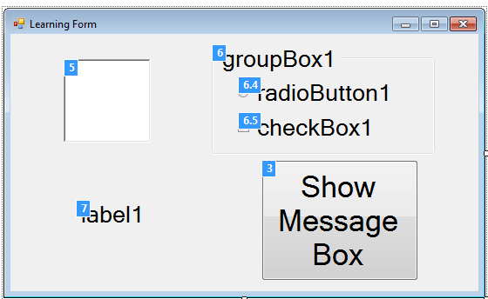
Represents a window or dialog box that makes up an application’s user interface
Windows Form
Create Form
Popular Properties
Popular Events
Tab order

Slide 6
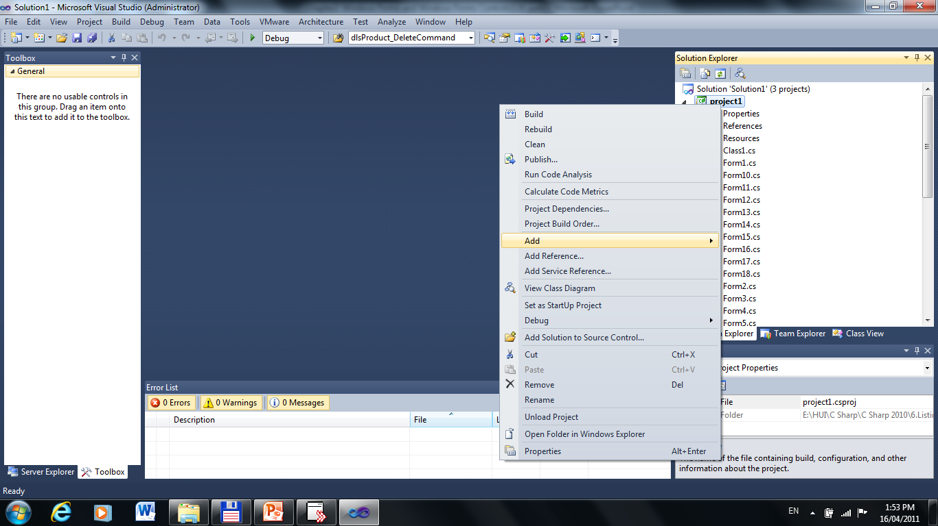
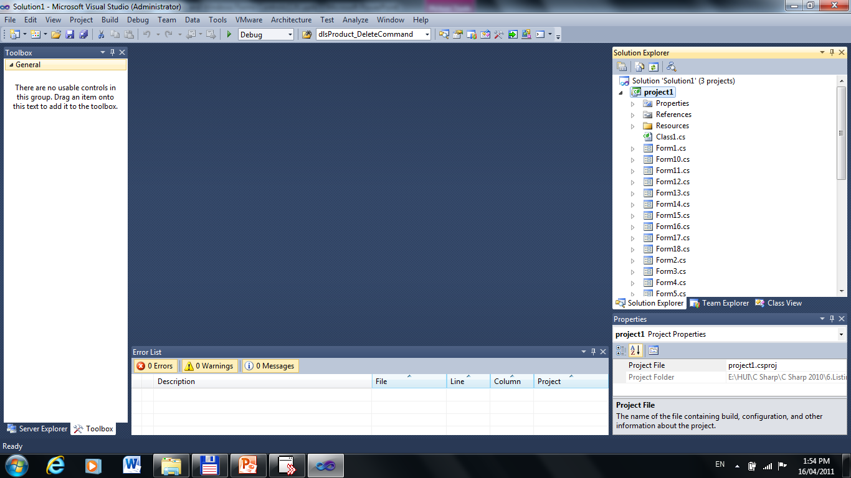

Create Form
Right Click on Project Name
Choose Add Item
Choose Windows Form…

Slide 7
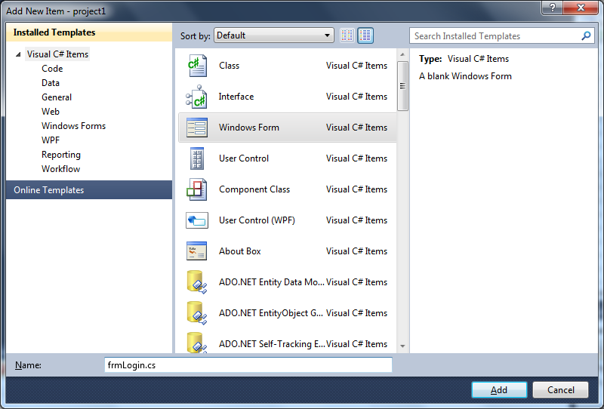
1.Choose Windows Form
2. Enter name
frmLogin.cs
3.Click “Add” button to create

Slide 8
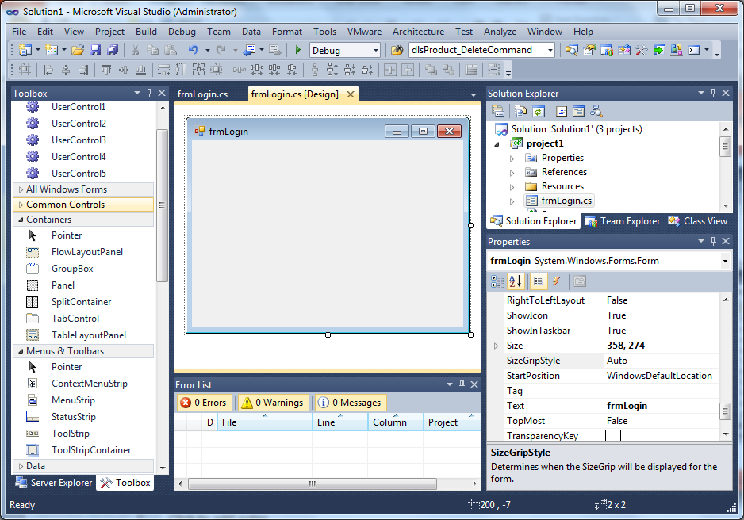

Slide 9
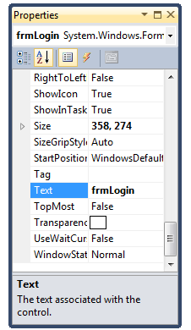
Popular Properties

Slide 10
Name | Description
Text | Gets or sets the text associated with this control
Name | Gets or sets the Name
Size | Gets or sets the size of the form.
WindowState | Gets or sets the form's window state. Normal; Minimized; Maximized
Font | Gets or sets the font of the text displayed by the control

Slide 11
Name | Description
StartPosition | Gets or sets the starting position of the form at run time. Manual CenterScreen WindowsDefaultLocation WindowsDefaultBounds CenterParent
TopMost | Gets or sets a value indicating whether the form should be displayed as a topmost form.

Slide 12
Name | Description
FormBorderStyle | Gets or sets the border style of the form None FixedSingle Fixed3D FixedDialog Sizable FixedToolWindow SizableToolWindow

Slide 13
Name | Description
BackColor | Gets or sets the background color for the control
BackGroundImage | Gets or sets the background image displayed in the control
MainMenuStrip | Gets or sets the primary menu container for the form
ForceColor | Gets or sets the foreground color of the control

Slide 14
Name | Description
Cursor | Gets or sets the cursor that is displayed when the mouse pointer is over the control
Location | Gets or sets the Point that represents the upper-left corner of the Form in screen coordinates
Icon | Gets or sets the icon for the form.
Opacity | Gets or sets the opacity level of the form

Slide 15
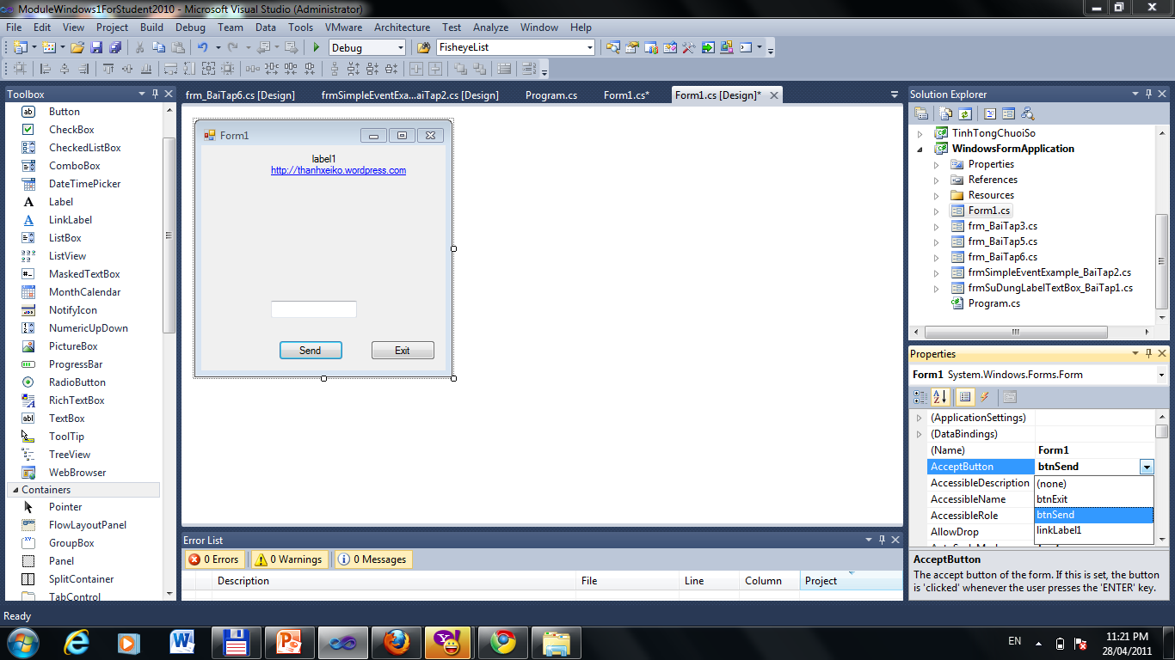
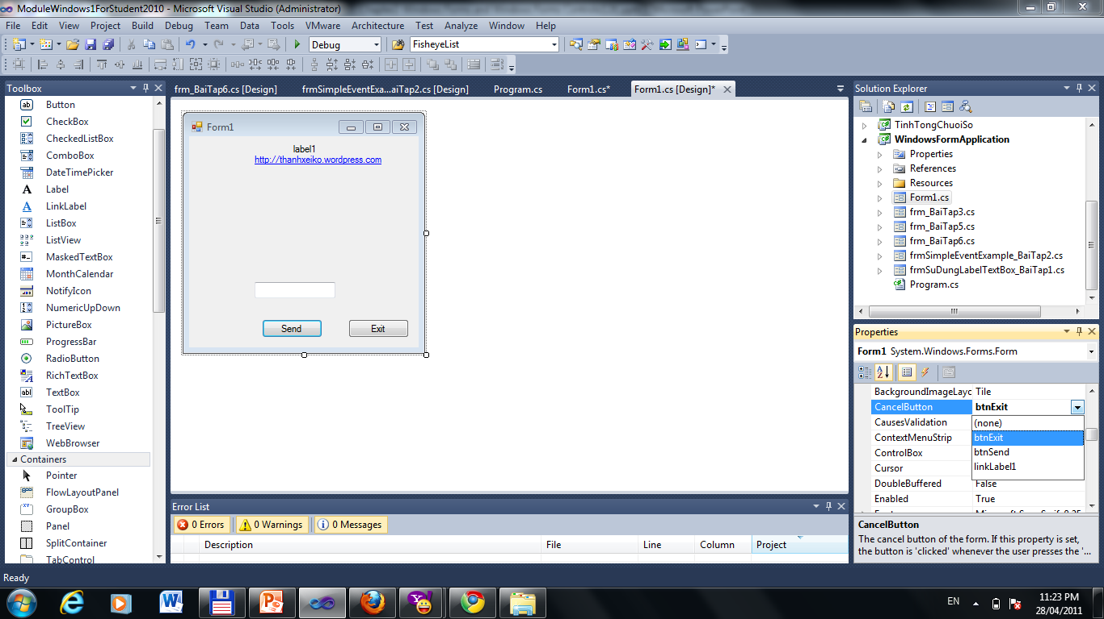
Name | Description
AcceptButton | Gets or sets the button on the form that is clicked when the user presses the ENTER key.
CancelButton | Gets or sets the button control that is clicked when the user presses the ESC key

Slide 16
DEMO
Windows Forms

Slide 17
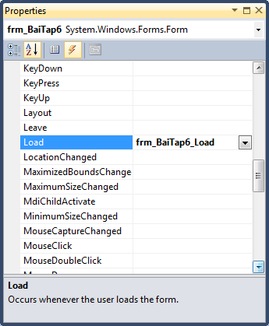
Popular Events
For Windows Forms & Another Controls

Slide 18
Name | Description
Click | Occurs when the control is clicked. (Inherited from Control.)
DoubleClick | Occurs when the control is double -clicked. (Inherited from Control.)
Load | Occurs before a form is displayed for the first time.
FormClosing | Occurs before the form is closed.
FormClosed | Occurs after the form is closed.

Slide 19
Name | Description
KeyDown | Occurs when a key is pressed while the control has focus. (Inherited from Control.)
KeyPress | Occurs when a key is pressed while the control has focus. (Inherited from Control.)
KeyUp | Occurs when a key is released while the control has focus. (Inherited from Control.)

Slide 20
Name | Description
MouseClick | Occurs when the control is clicked by the mouse. (Inherited from Control.)
MouseDoubleClick | Occurs when the control is double clicked by the mouse. (Inherited from Control.)
MouseDown | Occurs when the mouse pointer is over the control and a mouse button is pressed.(Control)

Slide 21
Name | Description
MouseEnter | Occurs when the mouse pointer enters the control.(Control)
MouseHover | Occurs when the mouse pointer rests on the control(Control)
MouseLeave | Occurs when the mouse pointer leaves the control. (Control)
MouseMove | Occurs when the mouse pointer is moved over the control. (Control)

Slide 22
Name | Description
MouseUp | Occurs when the mouse pointer is over the control and a mouse button is released.(Control)
MouseWheel | Occurs when the mouse wheel moves while the control has focus.(Control)

Slide 23
DEMO
Events

Slide 24
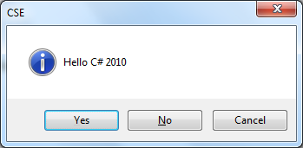
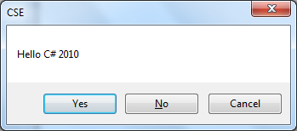
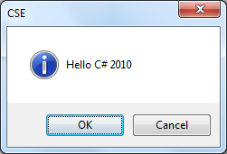
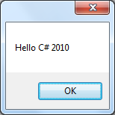
MessageBox class

Slide 25
Name | Description
Show(string) | Show a message box with text.
Show(string,string) | Show a message box with text and caption.
Show(string,string, MessageBoxButtons) | Show a message box with text, caption, and buttons.
Show(string,string, MessageBoxButtons, MessageBoxIcon) | Show a message box with text, caption, buttons, and icon.

Slide 26
MessageBox.Show("Hello 2017");
MessageBox.Show("Hello 2017","Title");
MessageBox.Show("Hello 2017","Title",
MessageBoxButtons.YesNoCancel);
MessageBox.Show("Hello 2017","Title",
MessageBoxButtons.OK,
MessageBoxIcon.Question);

Slide 27
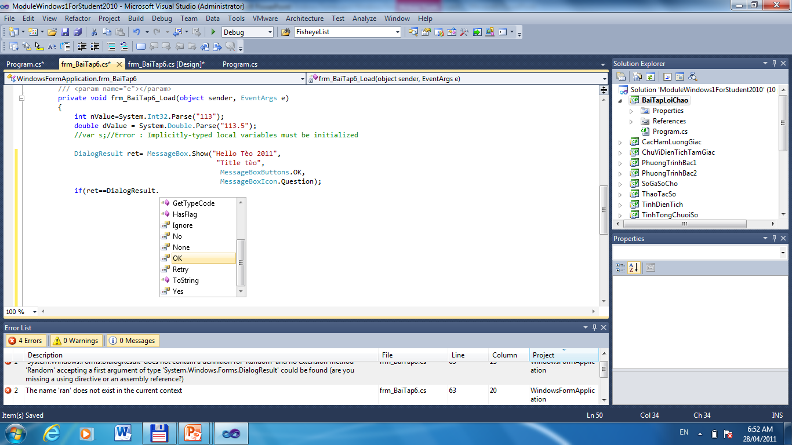

Slide 28
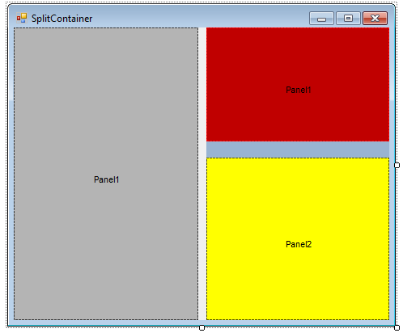
Panel & SplitContainer

Slide 29
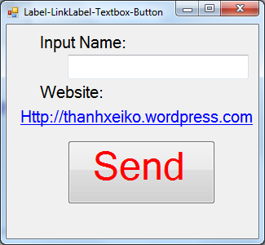
Label
LinkLabel
TextBox
Button

Slide 30
LinkLabel Events
Name | Description
LinkClicked | The LinkClicked event is handled to perform tasks when the user clicks on a link in the control. It is passed an instance of the LinkLabelLinkClickedEventArgs class

Slide 31
private void linkLabel1_LinkClicked(object sender,
LinkLabelLinkClickedEventArgs e)
{ switch (e.Button)
{
case MouseButtons.Left:
System.Diagnostics.Process.Start(linkLabel1.Text);
break;
case MouseButtons.Right:
MessageBox.Show("Right Click");
break;
case MouseButtons.Middle:
MessageBox.Show("Middle Click", "Title", MessageBoxButtons.YesNoCancel,
MessageBoxIcon.Information);
break;
}
}

Slide 32
How add LinkLabel
control & event at Runtime?

Slide 33
private LinkLabel linkTeo;
private void Form1_Load(object sender, EventArgs e)
{ //Create the linklabel
linkTeo = new LinkLabel();
//set location for linklabel
linkTeo.Location =new System.Drawing.Point(100, 100);
//Set the text for linklabel
linkTeo.Text= "http://thanhxeiko.wordpress.com";
//Add the controls to the form
this.Controls.Add(linkTeo);
//Add an event at runtime
linkTeo.LinkClicked += linkTeo_Clicked;
}
private void linkTeo_Clicked(object sender, LinkLabelLinkClickedEventArgs e)
{ if (sender is LinkLabel)
MessageBox.Show(((LinkLabel)sender).Text);
MessageBox.Show("Add event at runtime");
}

Slide 34
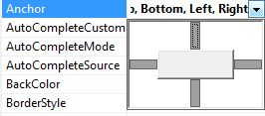
TextBox – Properties - Events
Name | Description
Anchor | Gets or sets the edges of the container to which a control is bound and determines how a control is resized with its parent Top Left Right Bottom

Slide 35
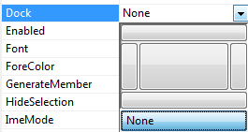
Name | Description
Dock | Gets or sets which control borders are docked to its parent control and determines how a control is resized with its parent None Top Left Right Bottom Fill

Slide 36
Name | Description
Multiline | Gets or sets a value indicating whether this is a
PasswordChar | Gets or sets the character used to mask characters of a password in a single-line TextBox control
ReadOnly | Gets or sets a value indicating whether text in the text box is read-only.

Slide 37
Name | Description
UseSystemPasswordChar | Gets or sets a value indicating whether the text in the TextBox control should appear as the default password character
Visible | Gets or sets a value indicating whether the control and all its child controls are displayed.
Enabled | Gets or sets a value indicating whether the control can respond to user interaction.

Slide 38
Name | Description
TextChanged | Occurs when the Text property value changes.
private void txtName_TextChanged (object sender, EventArgs e)
{
this.Text = txtName.Text;
}

Slide 39
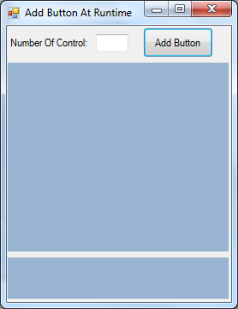
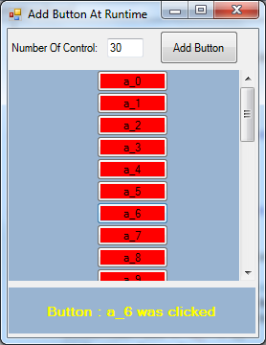
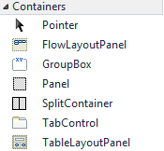
Add Button & Event at Runtime
txtNumberControl
btnAddButton
pnButton
AutoScroll=true
lblMessage

Slide 40
private void btnAddButton_Click(object sender, EventArgs e)
{
pnButton.Controls.Clear();
for (int i = 0; i < Int32.Parse(txtNumberControl.Text); i++)
{Button btnRuntime = new Button();
btnRuntime.BackColor = Color.Red;
btnRuntime.Location = new System.Drawing.Point (pnButton.Width/2-btnRuntime.Width/2,
i * btnRuntime.Height);
btnRuntime.Text = "a_" + i;
btnRuntime.Tag = i;
btnRuntime.Click += btnRuntime_click;
pnButton.Controls.Add(btnRuntime);}
}
private void btnRuntime_click(object sender, EventArgs e)
{
Button btn = (Button)sender;
lblMessage.Text = "Button : "+btn.Text +" was clicked";
}

Slide 41
GroupBox & RadioButton
Name | Description
Checked | Gets or sets a value indicating whether the control is checked
CheckAlign | Gets or sets the location of the check box portion of the RadioButton
if (radRed.Checked == true)
{
//do something for Red
}
radBlue.CheckAlign = ContentAlignment.MiddleLeft;

Slide 42
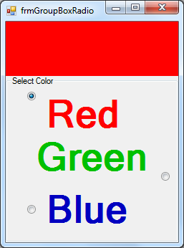
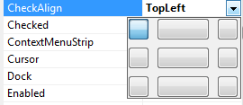
GroupBox & RadioButton
private void frmGroupBoxRadio_Load
(object sender, EventArgs e)
{
radRed.CheckedChanged += rad_CheckedChanged;
radGreen.CheckedChanged +=
rad_CheckedChanged;
radBlue.CheckedChanged += rad_CheckedChanged;
}
private void rad_CheckedChanged
(object sender, EventArgs e)
{
RadioButton rad = (RadioButton)sender;
pnColor.BackColor = rad.ForeColor;
}
pnColor

Slide 43
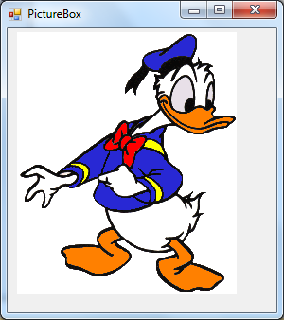
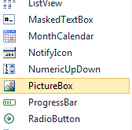
PictureBox control

Slide 44
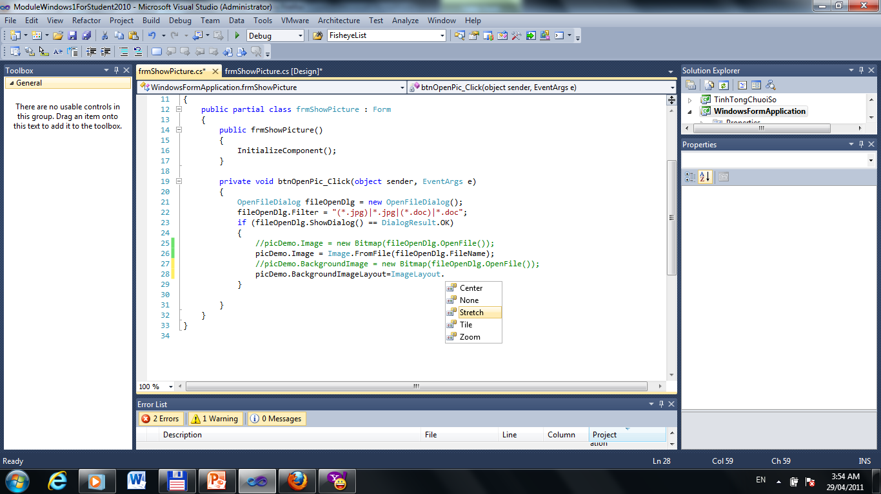
Name | Description
BackgroundImage | Gets or sets the background image displayed in the control
BackgroundImageLayout | Gets or sets the background image layout as defined in the ImageLayout enumeration

Slide 45
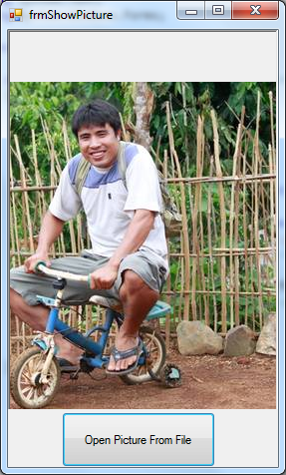
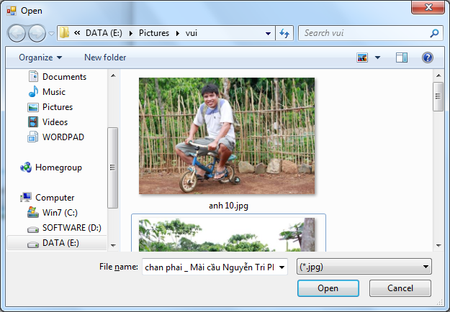
Get Picture from OpenFileDialog
picDemo

Slide 46
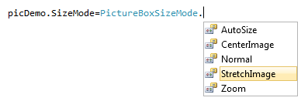
Name | Description
Image | Gets or sets the image that is displayed by PictureBox
SizeMode | Indicates how the image is displayed.

Slide 47
private void btnOpenPic_Click
(object sender, EventArgs e)
{
OpenFileDialog fileOpenDlg = new OpenFileDialog();
fileOpenDlg.Filter = "(*.jpg)|*.jpg|(*.doc)|*.doc";
if (fileOpenDlg.ShowDialog() == DialogResult.OK)
{
//picDemo.Image = new Bitmap(fileOpenDlg.OpenFile());
//Or
picDemo.Image = Image.FromFile(fileOpenDlg.FileName);
//Or
//picDemo.BackgroundImage = new Bitmap(fileOpenDlg.OpenFile());
}
}

Slide 48
Bài tập áp dụng

Slide 49
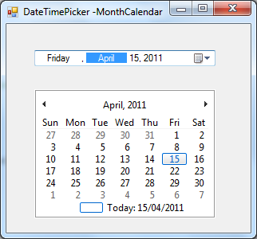
DateTimePicker & MonthCalendar

Slide 50
Name | Description
Format | Gets or sets the format of the date and time displayed in the control
CustomFormat | Gets or sets the custom date/time format string
Value | Gets or sets the date/time value assigned to the control.
dateTimePicker1.Format = DateTimePickerFormat.Custom;
dateTimePicker1.CustomFormat = "MMMM dd, yyyy - dddd";
Next Slide to see list Custom Format

Slide 51
Format string | Description
d | The one- or two-digit day.
dd | The two-digit day. Single-digit day values are preceded by a 0.
ddd | The three-character day-of-week abbreviation.
dddd | The full day-of-week name.
h | The one- or two-digit hour in 12-hour format.
hh | The two-digit hour in 12-hour format. Single digit values are preceded by a 0.
H | The one- or two-digit hour in 24-hour format.

Slide 52
Format string | Description
HH | The two-digit hour in 24-hour format. Single digit values are preceded by a 0.
m | The one- or two-digit minute.
mm | The two-digit minute. Single digit values are preceded by a 0.
M | The one- or two-digit month number.
mm | The two-digit minute. Single digit values are preceded by a 0.
M | The one- or two-digit month number.
MM | The two-digit month number. Single digit values are preceded by a 0.
MMM | The three-character month abbreviation.

Slide 53
Format string | Description
MMMM | The full month name.
s | The one- or two-digit seconds.
ss | The two-digit seconds. Single digit values are preceded by a 0.
t | The one-letter A.M./P.M. abbreviation (A.M. is displayed as "A").
tt | The two-letter A.M./P.M. abbreviation (A.M. is displayed as "AM").
y | The one-digit year (2001 is displayed as "1").
yy | The last two digits of the year (2001 is displayed as "01").
yyyy | The full year (2001 is displayed as "2001").

Slide 54
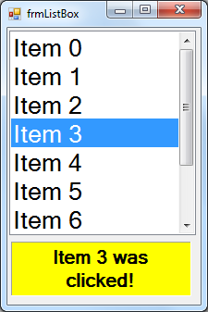
ListBox
private void
frmListBox_Load(object sender, EventArgs e)
{ listBox1.Items.Clear();
for (int i = 0; i < 10; i++)
listBox1.Items.Add("Item " + i);
}
private void listBox1_SelectedIndexChanged
(object sender, EventArgs e)
{
lblMessage.Text = listBox1.Text
+" was clicked!";
}

Slide 55
And We can use AddRange method to add data:
private void frmListBox_Load(object sender, EventArgs e)
{
string[] strArr = new string[] { “Tèo",“Tí","Bin","Bo"}; listBox1.Items.AddRange(strArr);
}

Slide 56
public class CStudent
{ private string m_strID;
private string m_strName;
public CStudent(string strID,
string strName)
{ this.m_strID = strID;
this.m_strName = strName;
}
public string ID
{ get { return this.m_strID; }
set { this.m_strID = value; }
}
public string Name
{ get { return this.m_strName; }
set { this.m_strName = value; }
}
}

Slide 57
using System.Collections;
Also We can use DataSource to display data
ArrayList arr = new ArrayList();
for(int i=0;i<10;i++)
{arr.Add(new CStudent("ID_"+i,"Name "+i));
}
listBox1.DataSource = arr;
listBox1.ValueMember = "ID";
listBox1.DisplayMember = "Name";

Slide 58
To get object from Listbox, We could use coding below:
if (listBox1.SelectedItem != null)
{
CStudent svTeo = (CStudent )
listBox1.SelectedItem;
lblMessage.Text = aStudent.Name
+ " Was selected";
}

Slide 59
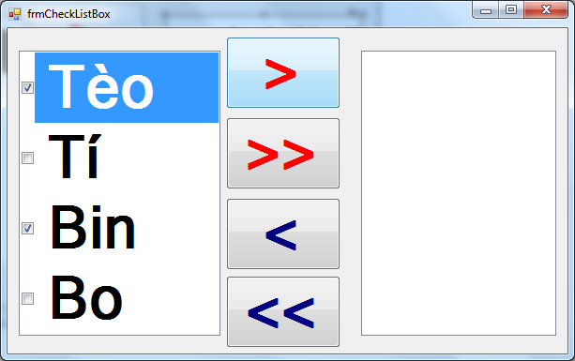
CheckedListBox
btnAdd
btnAddAll
chklbLeft
chklbRight
btnRemove
btnRemoveAll

Slide 60
Use Items to add data
private void frmCheckListBox_Load
(object sender, EventArgs e)
{ chklbLeft.Items.Add("Tèo"); chklbLeft.Items.Add("Tí"); chklbLeft.Items.Add("Bin"); chklbLeft.Items.Add("Bo");
}
Or we could use AddRange
chklbLeft.Items.AddRange(new string[] { "Tèo","Tí","Bin","Bo"});

Slide 61
How to process Items Checked???
Case 1:
CheckedListBox.CheckedIndexCollection indexCollection = chklbLeft.CheckedIndices;
string strChecked = "";
foreach (int i in indexCollection)
{
strChecked += i + ";";
}
MessageBox.Show(strChecked);

Slide 62
How to process Items Checked???
Case 2:
CheckedListBox.CheckedItemCollection items = chklbLeft.CheckedItems;
string strChecked = "";
foreach (string s in items)
{
strChecked += s + ";";
}
MessageBox.Show(strChecked);

Slide 63
How to process Items Checked???
Case 3:
string strChecked = "";
for (int i = 0; i < chklbLeft.Items.Count; i++){
if (chklbLeft.GetItemChecked(i))
{
//Process Item checked here
}
}

Slide 64
Go back ChecklistBox Example:
private void btnAdd_Click
(object sender, EventArgs e)
{
foreach(int i in chklbLeft.CheckedIndices)
{
chklbRight.Items.Add(chklbLeft.Items[i]);
}
foreach (string s in chklbRight.Items)
{chklbLeft.Items.Remove(s);}
}

Slide 65
private void btnAddAll_Click
(object sender, EventArgs e)
{ chklbRight.Items.AddRange
(chklbLeft.Items); chklbLeft.Items.Clear();
}

Slide 66
private void btnRemove_Click
(object sender, EventArgs e)
{
foreach (string s in chklbRight.CheckedItems)
chklbLeft.Items.Add(s);
foreach(string s in chklbLeft.Items)
chklbRight.Items.Remove(s);
}

Slide 67
private void btnRemoveAll_Click
(object sender, EventArgs e)
{
chklbLeft.Items.AddRange
(chklbRight.Items);
chklbRight.Items.Clear();
}

Slide 68
Bài tập áp dụng

Slide 69
Menu (2 ways to use)
MainMenu
MenuStrip
MenuItem
ToolStripMenuItem
Menu Property
MainMenuStrip
Property

Slide 70
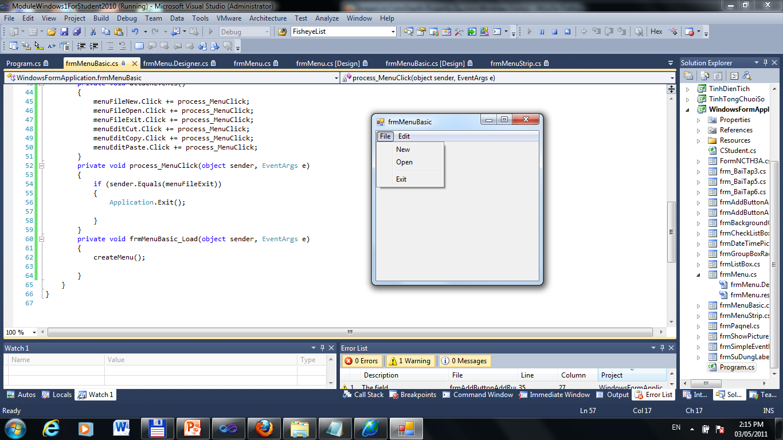
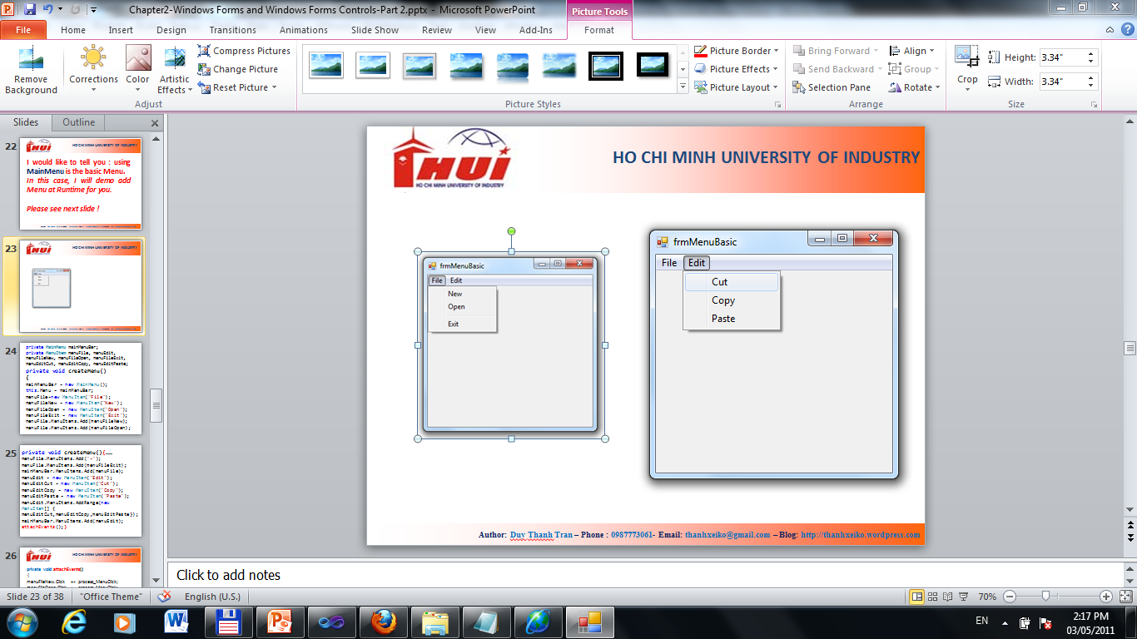
Coding to create Menu at Runtime

Slide 71
private MainMenu mainMenuBar;
private MenuItem menuFile, menuEdit, menuFileNew, menuFileOpen, menuFileExit, menuEditCut, menuEditCopy, menuEditPaste;
private void createMenu()
{
mainMenuBar = new MainMenu();
this.Menu = mainMenuBar;
menuFile=new MenuItem("File");
menuFileNew = new MenuItem("New");
menuFileOpen = new MenuItem("Open");
menuFileExit = new MenuItem("Exit");
menuFile.MenuItems.Add(menuFileNew);
menuFile.MenuItems.Add(menuFileOpen);

Slide 72
private void createMenu(){……
menuFile.MenuItems.Add("-");
menuFile.MenuItems.Add(menuFileExit);
mainMenuBar.MenuItems.Add(menuFile);
menuEdit = new MenuItem("Edit");
menuEditCut = new MenuItem("Cut");
menuEditCopy = new MenuItem("Copy");
menuEditPaste = new MenuItem("Paste");
menuEdit.MenuItems.AddRange(new MenuItem[] { menuEditCut,menuEditCopy,menuEditPaste});
mainMenuBar.MenuItems.Add(menuEdit);
attachEvents();}

Slide 73
private void attachEvents()
{
menuFileNew.Click += process_MenuClick;
menuFileOpen.Click += process_MenuClick;
menuFileExit.Click += process_MenuClick;
menuEditCut.Click += process_MenuClick;
menuEditCopy.Click += process_MenuClick;
menuEditPaste.Click += process_MenuClick;
}

Slide 74
private void process_MenuClick
(object sender, EventArgs e)
{
if (sender.Equals(menuFileExit))
{
Application.Exit();
}
}
private void frmMenuBasic_Load
(object sender, EventArgs e)
{createMenu();
}

Slide 75
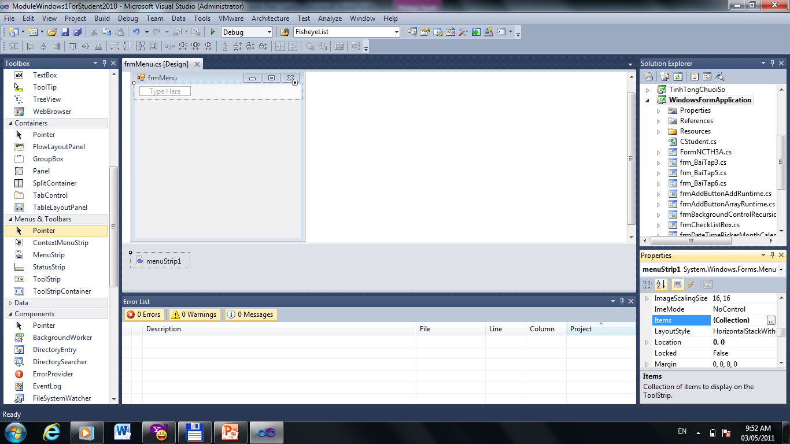
Designer
Click on button to add MenuItem

Slide 76
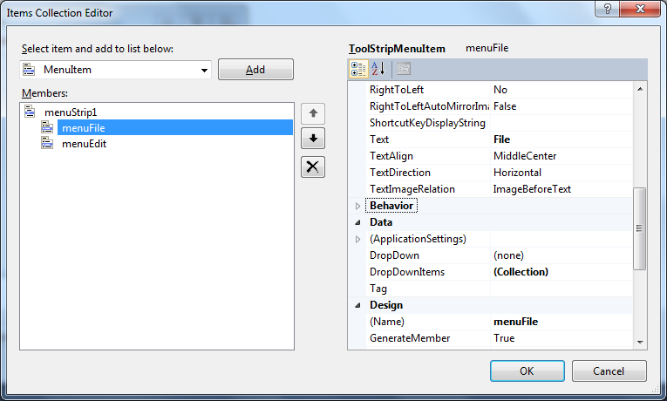
Click Add button to add new MenuItem
Text to Display
Click here to add Sub MenuItem
MenuItem’s Name

Slide 77
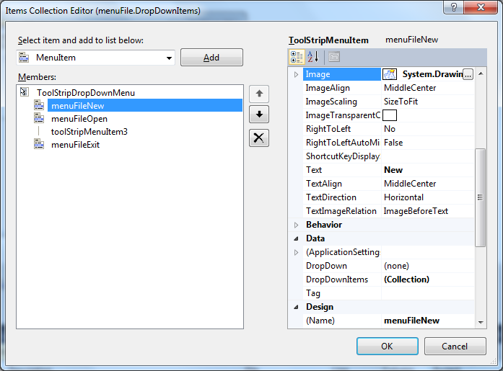
Image Icon
Text to Display
Click here to add Sub MenuItem
MenuItem’s Name

Slide 78
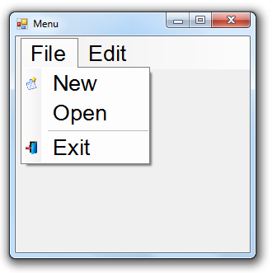
MenuStrip

Slide 79
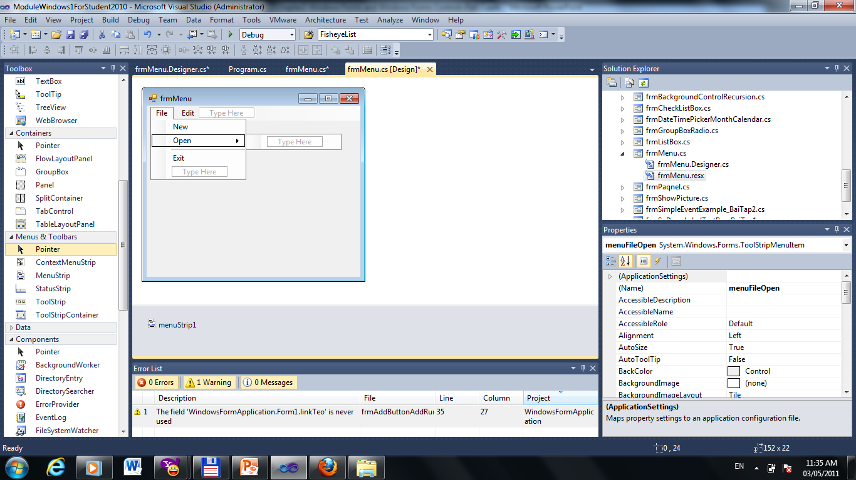
We could add MenuItem direct on the Windows Form. Enter Name in the “Type Here”

Slide 80
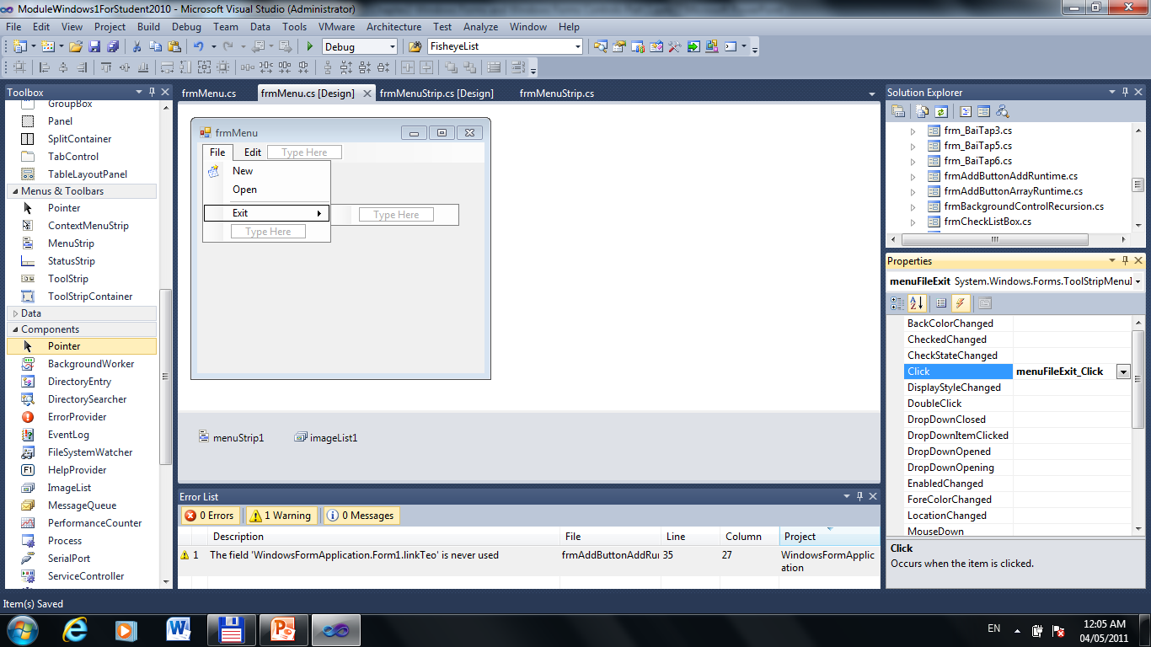
Add Event for each MenuItem

Slide 81
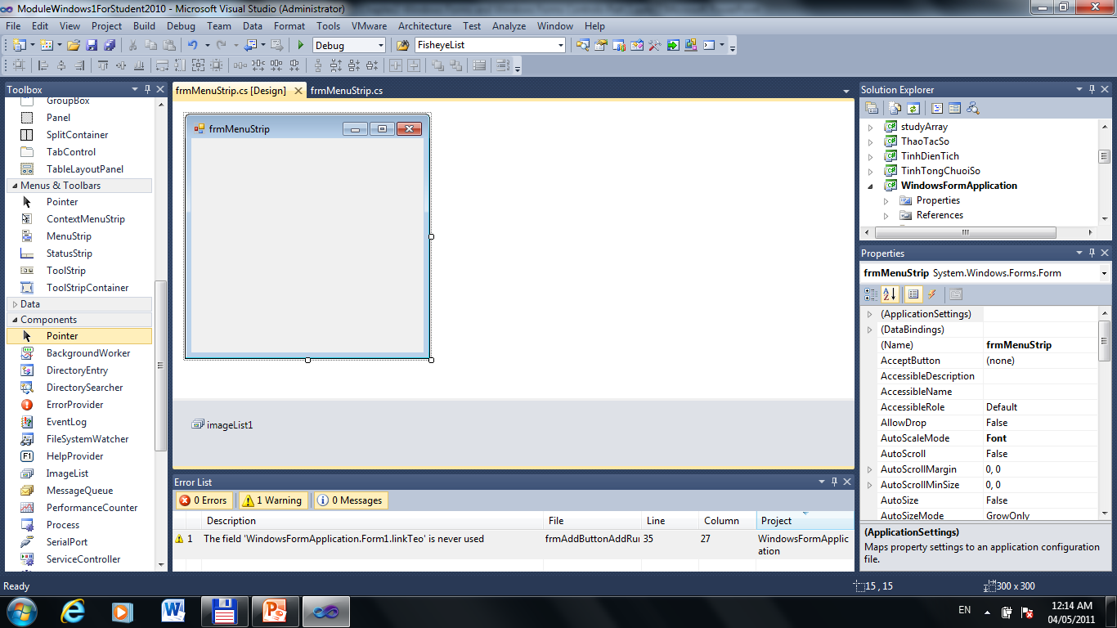
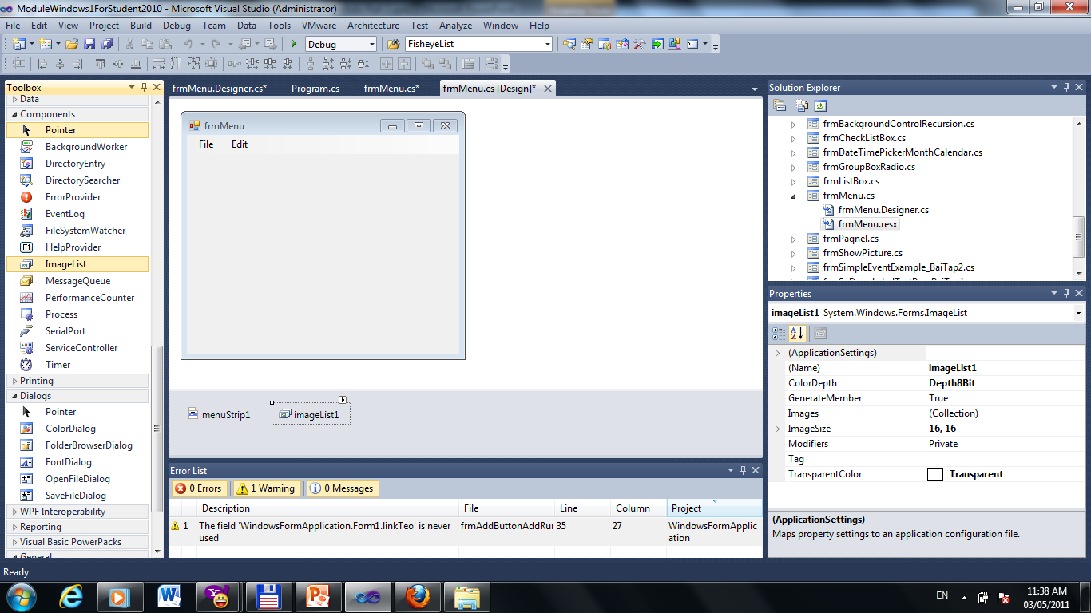
Image List
Drag & Drop

Slide 82
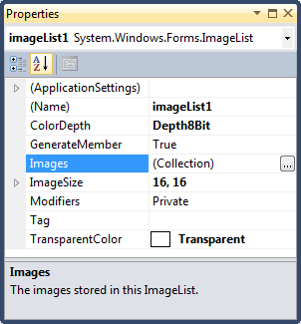
Gets the color depth of the image list
Gets the ImageList. ImageCollection for this image list. See Next Slide
Gets or sets the size of the images in the image list

Slide 83
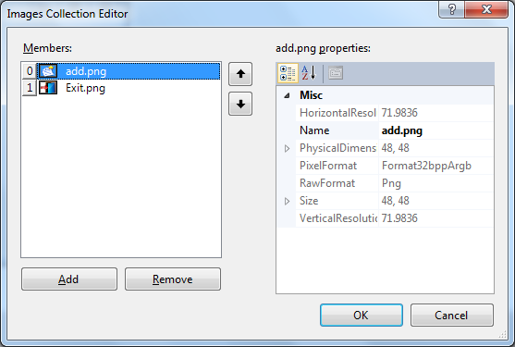
Click Add button to insert Image into Collection

Slide 84
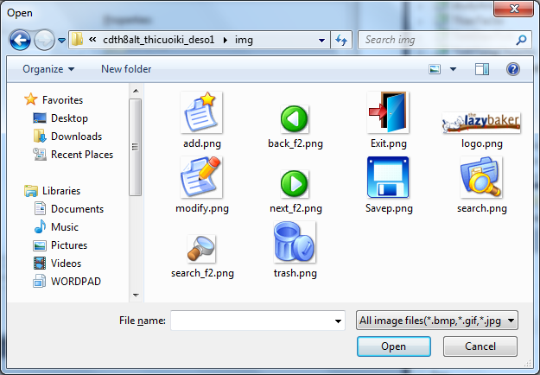
Select image & click Open

Slide 85
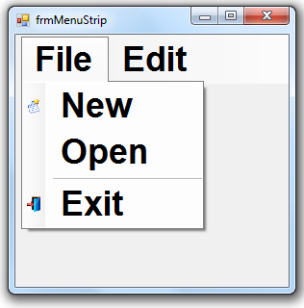
MenuStrip
At
Runtime

Slide 86
private MenuStrip menuBar;
private ToolStripMenuItem menuFile, menuEdit, menuFileNew, menuFileOpen, menuFileExit, menuEditCut, menuEditCopy, menuEditPaste;

Slide 87
private void createMenu()
{
menuBar = new MenuStrip();
menuBar.Font = new Font("arial", 36, FontStyle.Bold, GraphicsUnit.Pixel);
this.MainMenuStrip = menuBar;
menuFile = new ToolStripMenuItem("File");
menuFileNew = new ToolStripMenuItem("New");
menuFileNew.Image = imageList1.Images[0];

Slide 88
menuFileOpen = new ToolStripMenuItem("Open");
ToolStripSeparator sp = new ToolStripSeparator();
menuFileExit = new ToolStripMenuItem("Exit");
menuFileExit.Image = imageList1.Images[1];
menuFile.DropDownItems.Add(
menuFileNew);
menuFile.DropDownItems.Add(
menuFileOpen);

Slide 89
menuFile.DropDownItems.Add(sp); menuFile.DropDownItems.Add(
menuFileExit);
menuEdit = new ToolStripMenuItem("Edit");
menuEditCut = new ToolStripMenuItem("Cut");
menuEditCopy = new ToolStripMenuItem("Copy");
menuEditPaste = new ToolStripMenuItem("Paste");

Slide 90
menuEdit.DropDownItems.AddRange(new ToolStripItem[] { menuEditCut,menuEditCopy,
menuEditPaste});
menuBar.Items.AddRange(new ToolStripItem[] { menuFile,menuEdit});
this.Controls.Add(menuBar);
attachEvents();
}
private void attachEvents()
{menuFileExit.Click += processClick; }

Slide 91
private void processClick
(object o, EventArgs e)
{
if (o.Equals(menuFileExit))
Application.Exit();
}
private void frmMenuStrip_Load
(object sender, EventArgs e)
{
createMenu();
}

Slide 92
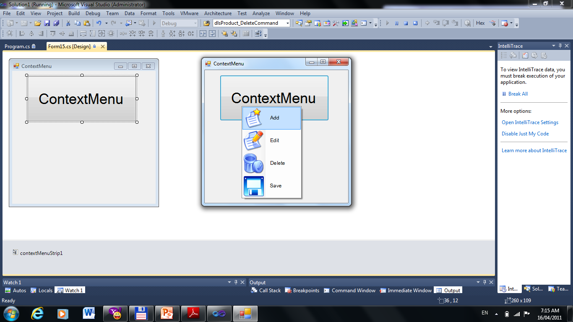
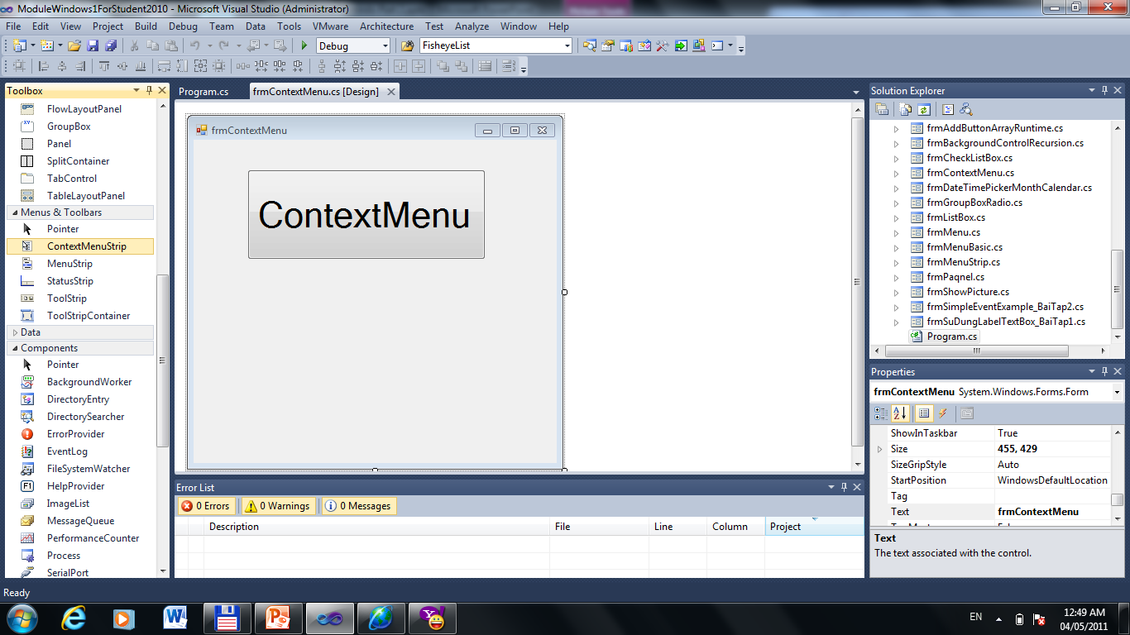
ContextMenuStrip
Drag & Drop into the FORM

Slide 93
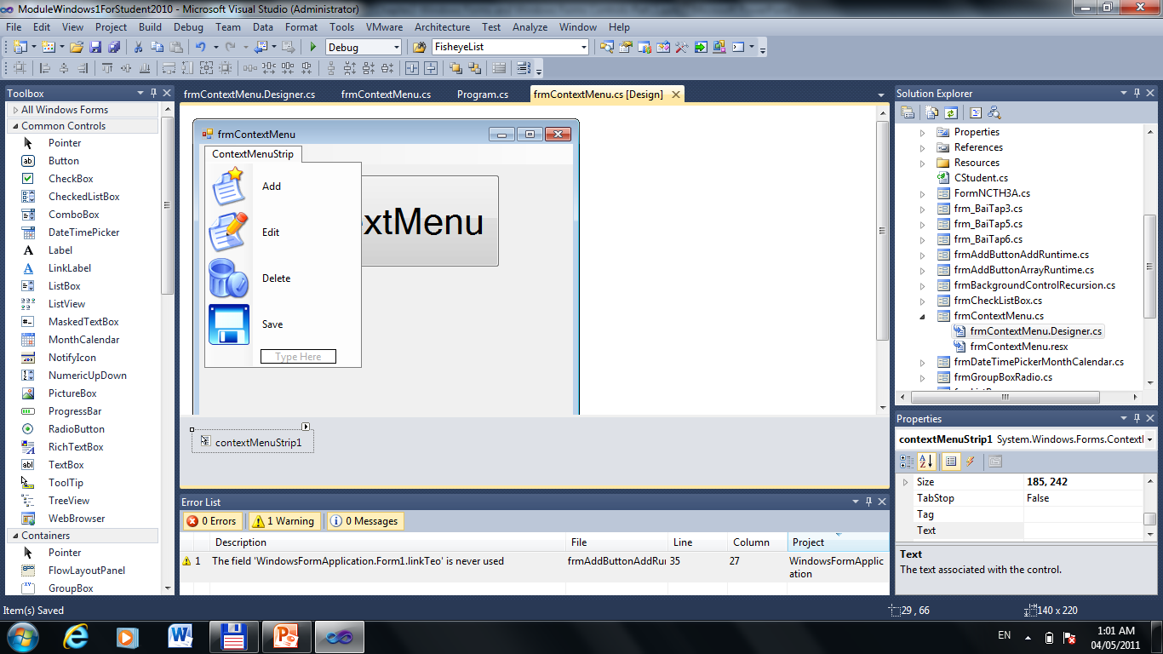
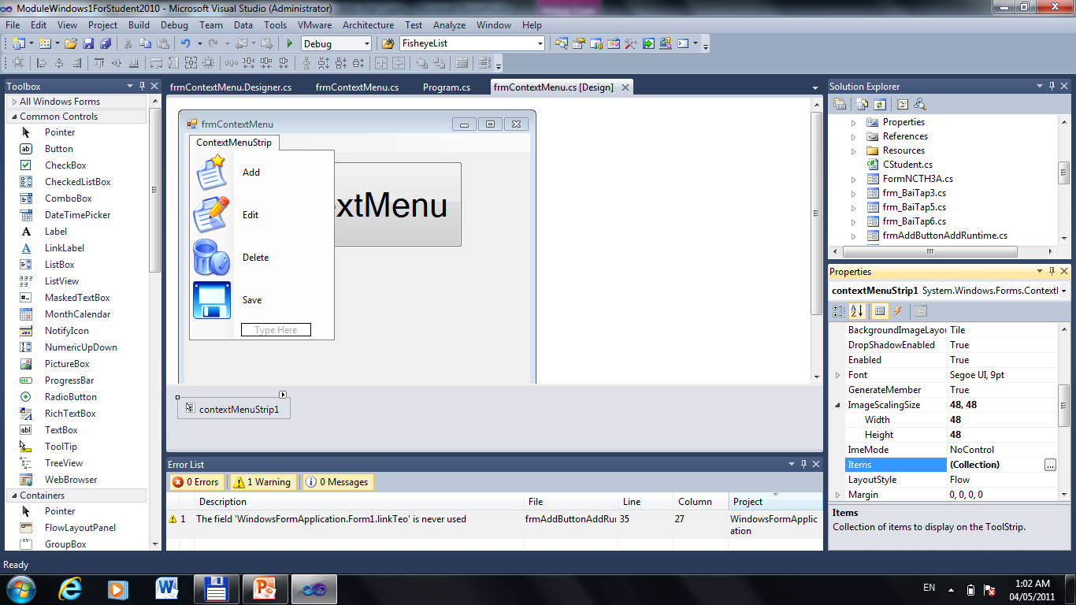
ImageScalingSize to set Width, Height Icon
Click Items (Collection) to add MenuItem

Slide 94

As the same
MenuStrip

Slide 95

1.Choose button
2.Set ContextMenuStrip
3.Attach event as the same MenuStrip

Slide 96

ToolStripContainer & ToolStrip

Slide 97

ToolStripContainer

Slide 98
ToolStripContainer Provides panels on each side of the form and a central panel that can hold one or more controls

Slide 99

Drag & Drop
ToolStrip into
the Form

Slide 100

As the same MenuStrip

Slide 101

Add Items Collection for ToolBar

Slide 102

Attach Events for each Item

Slide 103
Bài tập áp dụng

Slide 104


ColorDialog
pnColor
How to use ColorDialog?
btnColor

Slide 105
private void btnColor_Click
(object sender, EventArgs e)
{
ColorDialog cldlg= new ColorDialog();
cldlg.Color = pnColor.BackColor;
if(cldlg.ShowDialog()==DialogResult.OK)
pnColor.BackColor = cldlg.Color;
}

Slide 106


If you want to set color by the RED, GREEN, BLUE. Please see figure below:
pnColor
trackBarRed
txtRed
trackBarGreen
txtGreen
trackBarBlue
txtBlue

Slide 107

For each trackbar, please set properties as the same figure

Slide 108
private void setColor(){
int nRed = trackBarRed.Value;
int nGreen = trackBarGreen.Value;
int nBlue = trackBarBlue.Value;
txtRed.Text = nRed+"";
txtBlue.Text = nBlue + "";
txtGreen.Text = nGreen+"";
pnColor.BackColor = Color.FromArgb(nRed, nGreen,nBlue);
}

Slide 109
Create Event or trackbar control
private void processTrackBar
(object sender, EventArgs e)
{
setColor();
}

Slide 110
private void frmColorDialog_Load
(object sender, EventArgs e)
{ trackBarBlue.Scroll += processTrackBar;
trackBarGreen.Scroll += processTrackBar;
trackBarRed.Scroll += processTrackBar;
setColor();
}

Slide 111
Name | Description
Maximum | The Maximum property sets the value of the track bar when the slider is all the way to the right
Minimum | Gets or sets the lower limit of the range this TrackBar is working with.
Value | Gets or sets a numeric value that represents the current position of the scroll box on the track bar

Slide 112
Name | Description
LargeChange | Sets how many positions to move if the bar is clicked on either side of the slider
SmallChange | sets how many positions to move if the keyboard arrows are used to move the slider
TickFrequency | Establishes how many positions are between each tick-mark

Slide 113


FontDialog
lblFont
How to use FontDialog?
btnFont

Slide 114
private void btnFont_Click
(object sender, EventArgs e)
{
FontDialog ftDialog = new
FontDialog();
ftDialog.Font = lblFont.Font;
if (ftDialog.ShowDialog() ==
DialogResult.OK)
{
lblFont.Font = ftDialog.Font;
}
}

Slide 115


RichTextBox & StreamFile

Slide 116
OpenFileDialog openDlg = new OpenFileDialog();
openDlg.Filter = "(*.txt)|*.txt|(All)|*.*";
if (openDlg.ShowDialog() == DialogResult.OK)
{
rtFile.LoadFile(openDlg.FileName, RichTextBoxStreamType.PlainText);
}

Slide 117

You could choose
StreamType

Slide 118
But We could use StreamFile
to read Data.
You should Know this

Slide 119
Add this command at the top File
using System.IO;
if (openDlg.ShowDialog() == DialogResult.OK)
{ //Open to read
Stream stream = openDlg.OpenFile();
StreamReader reader = new StreamReader(stream);
richTxtFile.Text = reader.ReadToEnd();
reader.Close();
}

Slide 120


RichTextBox & StreamFile

Slide 121
SaveFileDialog saveDlg = new SaveFileDialog();
saveDlg.Filter = "(*.txt)|*.txt|(All)|*.*";
if (saveDlg.ShowDialog() == DialogResult.OK)
{
rtFile.SaveFile(saveDlg.FileName,RichTextBoxStreamType.PlainText);
}

Slide 122
Use StreamFile to Write Data.
if (saveDlg.ShowDialog() == DialogResult.OK)
{
Stream stream = saveDlg.OpenFile();//Open to Write
StreamWriter writer = new StreamWriter(stream);
writer.WriteLine(rtFile.Text);
writer.Close();
}

Slide 123
Bài tập áp dụng

Slide 124

ListView
btnHeader
lvDataDn
btnAdd
txtID
txtName
btnRemove
dateBirthDay

Slide 125
private void btnLoadHeader_Click
(object sender, EventArgs e)
{
ColumnHeader hdID = new
ColumnHeader();
hdID.Text = "ID";
ColumnHeader hdName = new
ColumnHeader();
hdName.Text = "Name";
ColumnHeader hdBirthday = new
ColumnHeader();
hdBirthday.Text = "Birthday";

Slide 126
lvDataDn.GridLines = true;
lvDataDn.FullRowSelect = true;
lvDataDn.MultiSelect = true;
lvDataDn.HideSelection = false;
lvDataDn.View = View.Details;
hdID.Width = 100;
hdName.Width =140; hdBirthday.Width = 140;
lvDataDn.Columns.Clear();

Slide 127
lvDataDn.Columns.AddRange(new ColumnHeader[] { hdID,hdName,hdBirthday});
}
At Design Time
????

Slide 128
private void btnAdd_Click
(object sender, EventArgs e)
{
ListViewItem itemID = new ListViewItem();
itemID.Text = txtID.Text;
ListViewItem.ListViewSubItem itemName = new
ListViewItem.ListViewSubItem();
itemName.Text=txtName.Text; itemID.SubItems.Add(itemName);

Slide 129
ListViewItem.ListViewSubItem itemBirthday = new ListViewItem.ListViewSubItem();
itemBirthday.Text = dateBirthDay.Value.Day + "/" + dateBirthDay.Value.Month + "/" + dateBirthDay.Value.Year;
itemID.SubItems.Add(itemBirthday);
lvDataDn.Items.Add(itemID);
}

Slide 130
private void btnRemove_Click
(object sender, EventArgs e)
{ListView.
SelectedListViewItemCollection
list = lvDataDn.SelectedItems;
foreach (ListViewItem item in list)
lvDataDn.Items.Remove(item);
}

Slide 131
We could use Indices
ListView.SelectedIndexCollection indices = lvDataDn.SelectedIndices;
foreach (int index in indices)
{
//Process Index here
}

Slide 132

TreeView

Slide 133
ImageList
Popular Properties & Method
ImageIndex
SelectedImageIndex
TreeNode
SelectedNode
Add
Expand
Collapse
Nodes
Remove

Slide 134
private void frmTreeView_Load
(object sender, EventArgs e)
{cboImageIndex.Items.Clear();
for (int i = 0; i <
imgList.Images.Count;i++ )
{
cboImageIndex.Items.Add(i);
}
tvSample.ImageList = imgList;
}

Slide 135
private void btnAddRoot_Click
(object sender, EventArgs e)
{tvSample.Nodes.Clear();
TreeNode rootNode = new TreeNode(txtRoot.Text);
rootNode.ImageIndex = Int32.Parse(cboImageIndex.Text);
rootNode.SelectedImageIndex = rootNode.ImageIndex; tvSample.Nodes.Add(rootNode);
txtRoot.Text = "";
}

Slide 136
private void cboImageIndex_SelectedIndexChanged(object sender, EventArgs e)
{
picShow.Image=imgList.Images[Int32.Parse(cboImageIndex.Text)];
}

Slide 137
private void btnRemove_Click(object sender, EventArgs e)
{
TreeNode tNode =
tvSample.SelectedNode;
tvSample.Nodes.Remove(tNode);
}

Slide 138
Bài tập áp dụng

